Slide 1

Creating Graphic
IOT PROJECT

Slide 2
01
02
BASE
CODES
03
ADDITIONAL ITEMS
Creating the circuit
What are the codes used
What are the additional items used

Slide 3
Base
I was required to create a graphic using arduino and Vpython. Included items are
Arduino uno board
Ultrasonic Sensor HC-SR04
Additional items used are
LED (Red, Yellow, Green)
Grove-LCD RGB Backlight
Sound buzzer

Slide 4
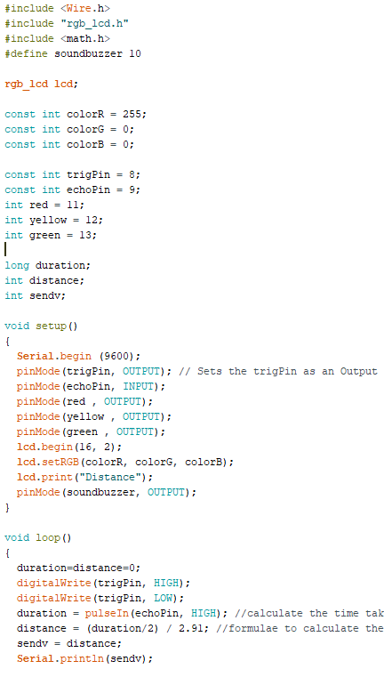
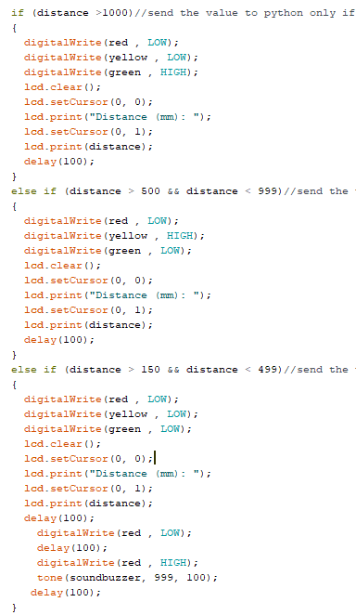
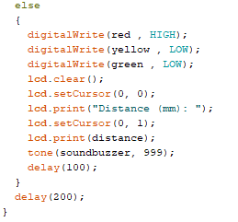
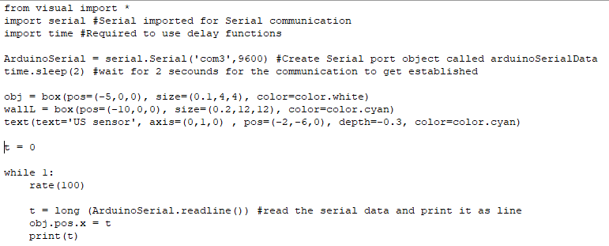
Codes Used

Slide 5
Additional Items
Additional items used are
LED (Red, Yellow, Green)
Grove-LCD RGB Backlight
Sound buzzer
The LEDs will light up and blink at certain points
The LCD will display the distance in (mm) in addition to the graphical display
The sound buzzer will buzz at certain points as well with different speed

